Slide 1
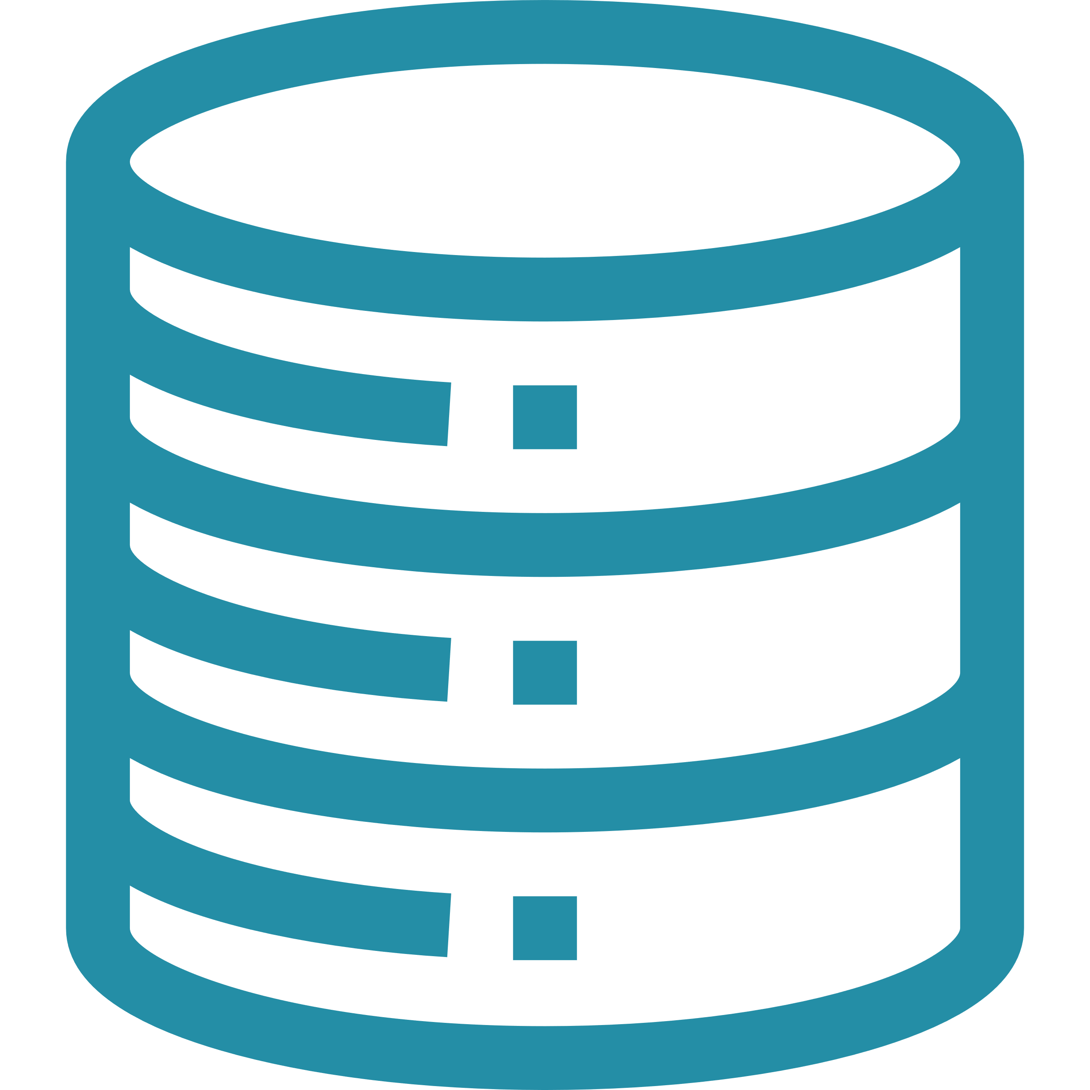

Existing Operational Analytics Solutions Are Hard
Separate Systems Require Complex Data Management Pipelines
Manual Data Pipelines
Expensive and cumbersome
to build and maintain ETL jobs
Complex reconstruction of the data, especially with schema changes
Incomplete, inconsistent, and stale views of data, limiting insights

Slide 2







Building with time-series data is challenging
RELATIONAL DATABASES
EXISTING TIME-SERIES SOLUTIONS
Inefficient at
processing time-series data
Data management issues with rigid schema
Limited integrations for ML, analytics, and data collection
Difficult to scale for large volumes of data
Minimal data lifecycle management
Real-time and historical data are decoupled

Slide 3


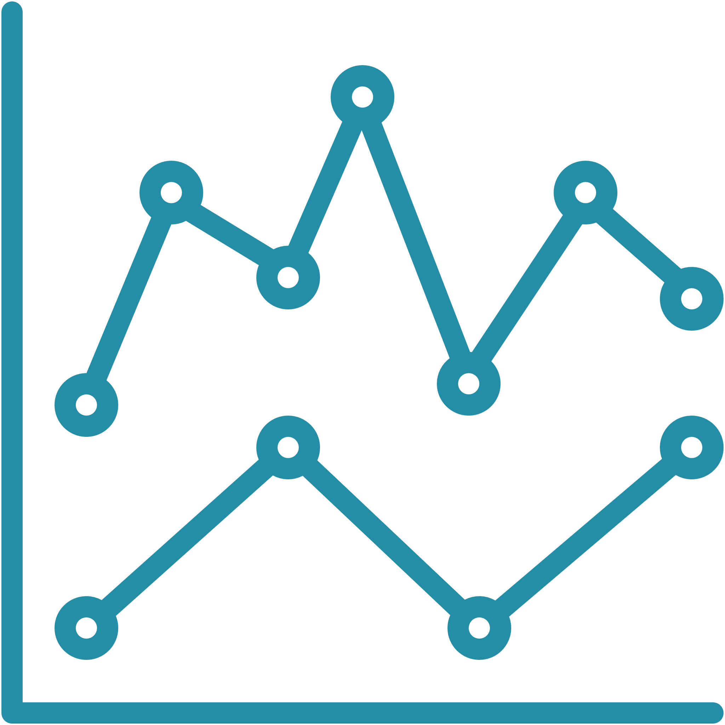

Existing Operational Analytics Solutions Are Hard
Separate Systems Require Complex Data Management Pipelines
Serverless and
easy to use
Performance
at scale
Purpose built for time-series data
Secure from the ground up
No servers to manage or instances to provision; software patches, indexes, and database optimizations are handled automatically
Capable of ingesting trillions of events daily; the adaptive SQL query engine provides rapid point-in-time queries with its in-memory store, and fast analytical queries through its magnetic store
Built-in analytics using standard SQL with added interpolation and smoothing functions to identify trends, patterns, and anomalies
All data is encrypted in flight and at rest using AWS Key Management Service (AWS KMS) with customer- managed
keys (CMKs)

Slide 4





. . . Has Many Challenges!
Set up
Build
Analyze
Productionize
Unrelated data sources with different stores and granularities
Investment Hypothesis
Multiple distribution mechanisms with integration and scalability challenges
Inconsistent semantics and data models
Multiple programmatic interfaces to access data

Slide 5
The Five Layers Of The Cloud Blueprint Layered Model
Product
Platform architecture
Network architecture
Foundaton architecture
Microservices blueprint
Layer 5
App 1
App 2
App 3
App 4
App 5
App 6
Containers, AWS Auto Scaling Groups, Amazon EC2 instances, tagging
Product
Layer 5
App 1
App 2 App 3
App 4
App 5
App 6
App 1
Platform architecture
Voice analytics
Anomaly detection
Data processing
Layer 4
Machine learning
Microservices WebApp
Voice
analytics detection
Custom
Anomaly
Security
Data Lake
Data processing
Machine learning
Elastic load balancers, Amazon S3 buckets, bucket policies, security groups, Amazon CloudWatch, tagging, managed services such as Amazon EKS, AWS Lake Formation, Amazon SageMaker
Network architecture
Layer 3
Network 1
Network 2
Network 3
External connectivity
Third-party connectivity
Cloud-to JPMC connectivity
Microservices WebApp
VPC-to-VPC
connectivity
Layer 4
App 1
Custom
Layer 2
Foundation architecture
Layer 1
Roles, users, configuration, encryption, SIEM, etc.
Data Lake
Security
Amazon VPCs, subnets, AWS Transit Gateway, route tables, NACLS, security groups
AI / ML blueprint
Network 1
Network 3
Layer 3
Network 2
App 1
Product
App 1
Layer 5
App 2 App 3
App 4
App 5
App 6
Platform architecture
Voice analytics | Anomaly detection | Data processing | Microservices | WebApp | Custom
Machine learning
Data Lake
External Third-party connectivity connectivity
VPC-to-VPC
connectivity
Cloud-to- JPMC
connectivity
AWS Direct Connect, AWS Transit Gateway, virtual gateway, VPN connection
Layer 4
Layer 2
App 1
Security
Layer 3
Network 2
Network architecture
Network 1
Network 3
Roles, users, configuration, encryption, SIEM, etc.
Users, groups, roles, policies, AWS CloudTrail, authentication, continuous monitoring (SIEM)
External connectivity
Third-party connectivity
Cloud-to JPMC connectivity
Layer 2
VPC-to-VPC
connectivity
Layer 1
App 1
Foundation architecture
Layer 1
Roles, users, configuration, encryption, SIEM, etc.
Key benefits
Modular configuration
Version controlled
Agile-lean delivery
Shared responsibility model
Reusable modules
Modular teams
Loosely coupled
Automate and enforce guardrails

Slide 6
The Data-driven Investment Process . . .
Set up
Build
Analyze
Productionize
Source data Clean and normalize Model
Investment Hypothesis
Create a strategy Optimize Backtest
Compare metrics Run scenarios
Execute trades Monitor risk

Slide 7
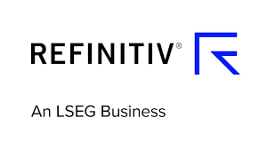
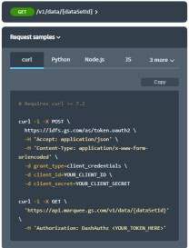




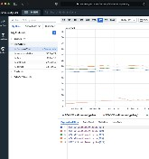
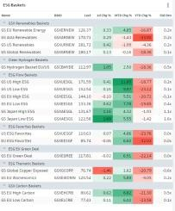
Cloud-native Event-driven Pipeline
REST APIs
GS
Financial Cloud
ESG scores
Carbon performance
GS Quant
Curated
Data
Data Management
Data
Analytics
Pricing Data
PlotTool Pro
Elektron Real-Time
Set up
Build
Analyze
Productionize
DataScope Plus

Slide 8






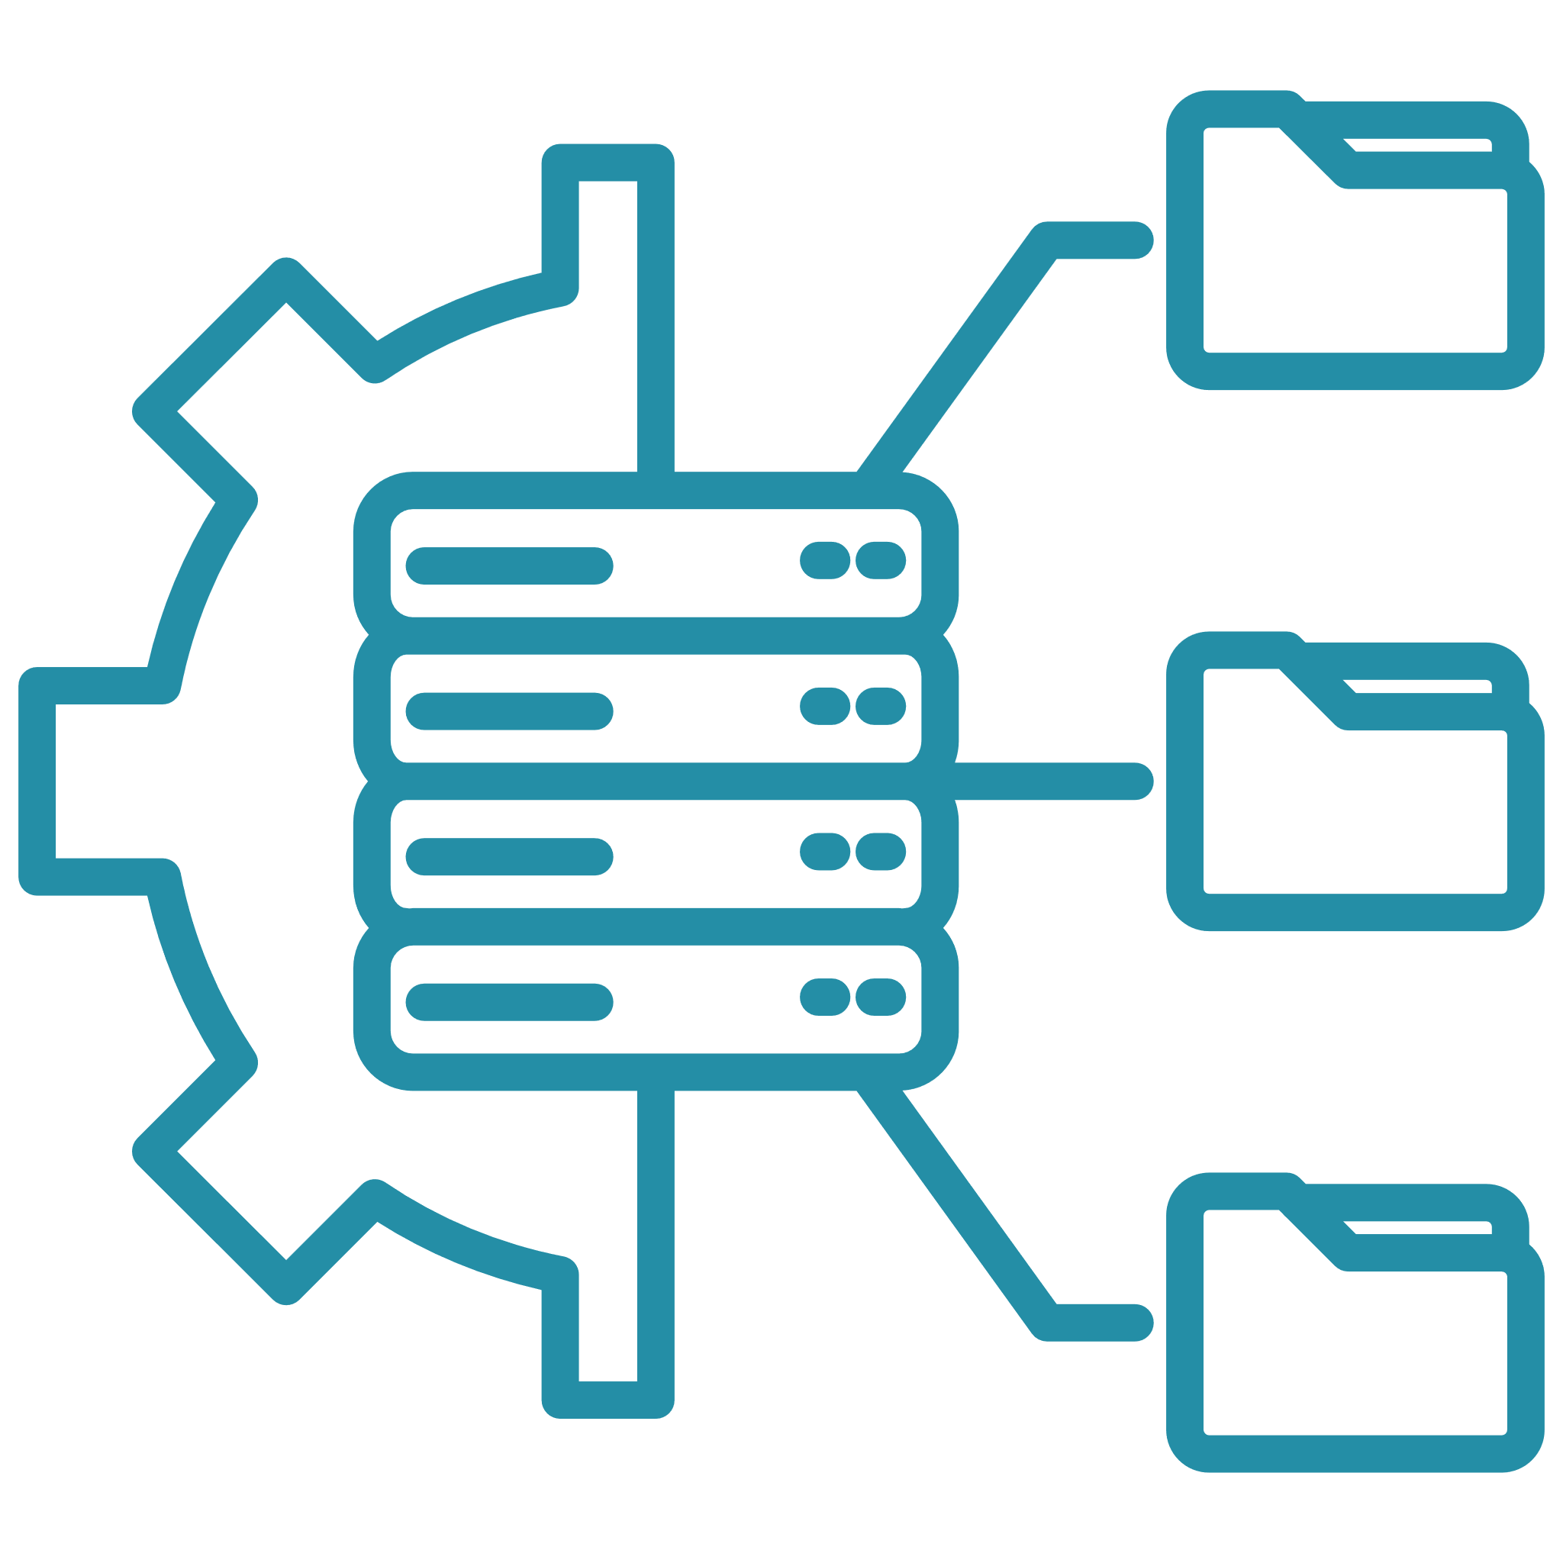





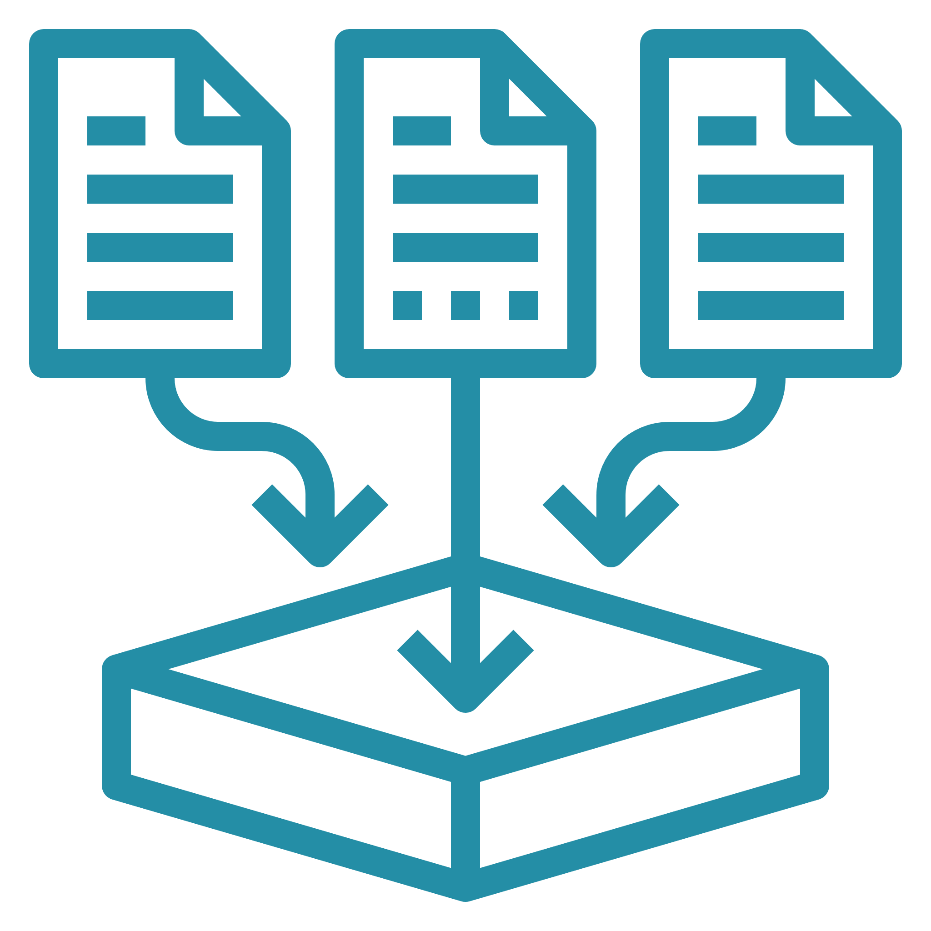
Architecture
Data sources
Amazon FinSpace
Data consumers
First- party data
Internal data sources
Interface
Web Ui
Notebooks
Python SDK
Enterprise data lake
Data analysts
Second- party data
Data Managment
Data Organization
Prepare & Analyze
Business line databases
Optimized views
Search & Browse
Machine learning
Business analysts
External data sources
Data Varisioning
Business data catalog
Time series analytics
Data scientists
Third- party data
Storage
Metadata
Managed Spark clusters
Third-party data feeds
Governance and audit
Applications, engines, and algorithms
Alternative data
Data access management
Resource access control
Audit reporting

Slide 9
GS Financial Cloud for Data
A modular set of cloud-native services to help clients accelerate their technology strategy and deliver enhanced financial market analytics
Curated data
Data management
Data analytics
GS proprietary data
Fully managed time-series DB, specialized for financial data
GS Quant – Goldman Sachs open-source Python SDK
Third-party data products
Integrated Security Master Service
PlotTool Pro – data visualization and analytic engine
Consistent data model
REST APIs
Normalized and curated reference data

Slide 10


AWS offers unmatched capabilities for your data needs
Comprehensive
Integrated
Governed
The most comprehensive set of services with optimal price performance for any use case
Choices for integrating data including zero-ETL so you can easily connect to all your data
End-to-end data governance capabilities help you move faster with data

Slide 11



AWS Glue: Complete data integration capabilities in one place
Stream processing
Batch processing
Event processing
More easily integrate with Amazon MSK, Amazon Kinesis, and Apache Kafka
Combine, enrich, and transform data using AWS Glue Studio
Adapt to varied and
changing schemas

Slide 12
AWS Glue: Complete data integration capabilities in one place
Stream processing
Batch processing
Event processing
More easily integrate with Amazon MSK, Amazon Kinesis, and Apache Kafka
Combine, enrich, and transform data using AWS Glue Studio
Adapt to varied and
changing schemas

Slide 13


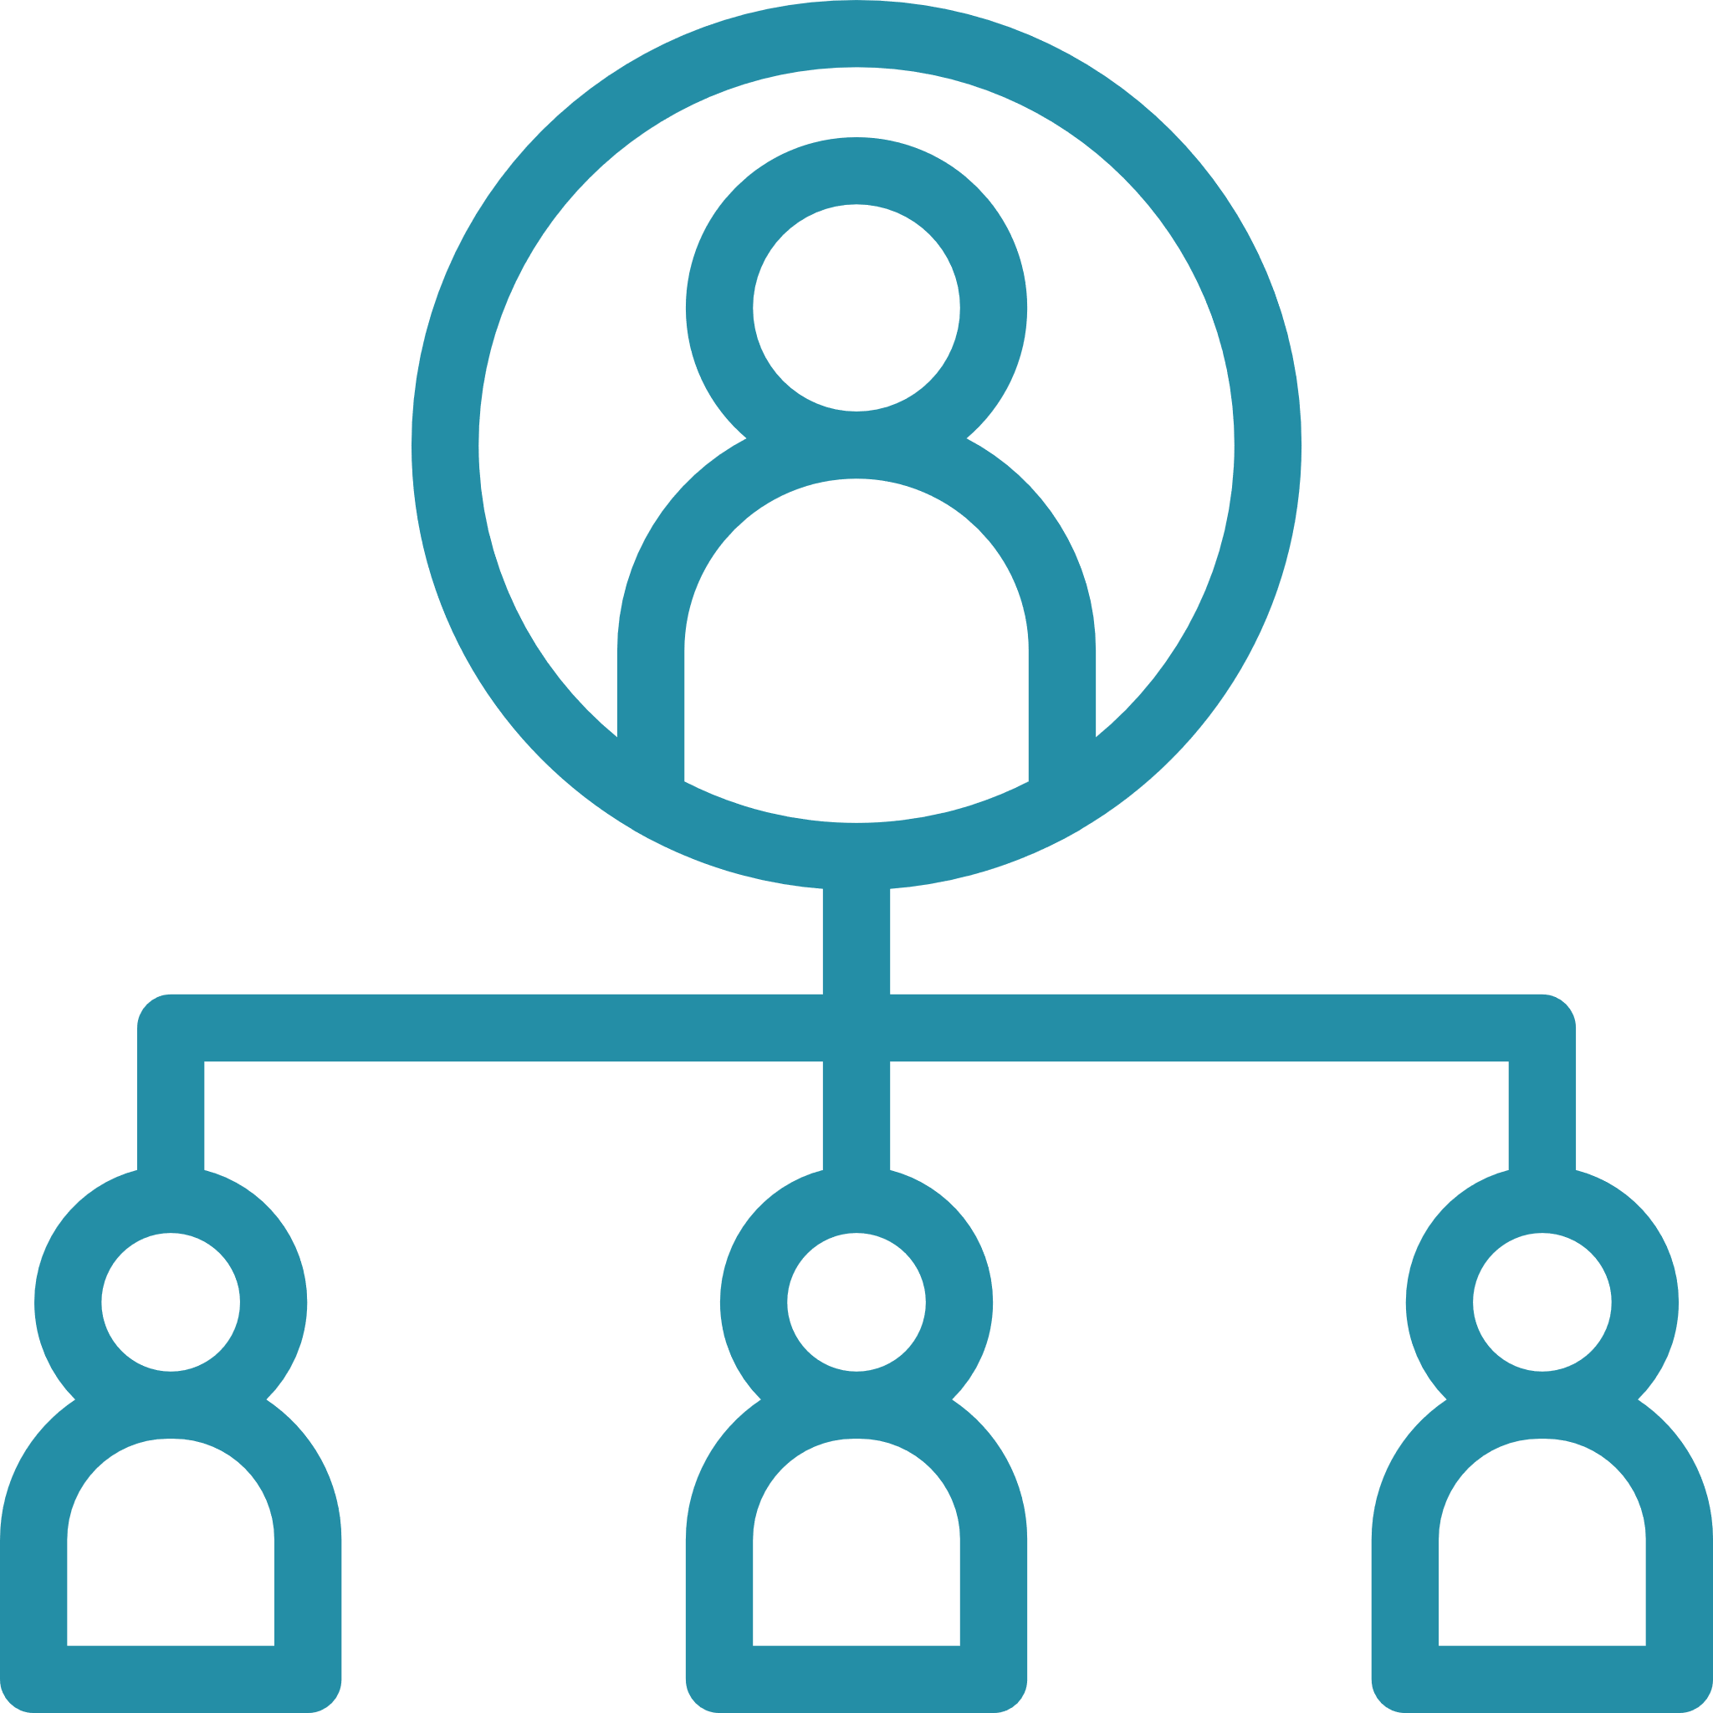
Why no-code?
A modular set of cloud-native services to help clients accelerate their technology strategy and deliver enhanced financial market analytics
Democratize Innovation
Improve Productivity
Extend Team
Empower business users
Harness the power of AWS without writing a single line of code
Grow your technical teams without relying on developer talent pools that are in high demand
Enable rapid prototyping
Remove communication barriers between
business and IT

Slide 14


Amazon Timestream
F a s t , s c a l a b l e , a n d s e r v e r l e s s t i m e - s e r i e s d a t a b a s e
Serverless And
Easy To Use
Performance
At Scale
Purpose Built For
Time-series Data
Secure From
The Ground Up
No servers to manage or instances to provision; software patches, indexes, and database optimizations are handled automatically
Capable of ingesting trillions of events daily; the adaptive SQL query engine provides rapid point-in-time queries with its in-memory store, and fast analytical queries through its magnetic store
Built-in analytics using standard SQL with added interpolation and smoothing functions to identify trends, patterns, and anomalies
All data is encrypted in flight and at rest using AWS Key Management Service (AWS KMS) with customer- managed keys (CMKs)

Slide 15





Companies Expect More Value From Their Data
Growing
exponentially
From new
sources
Increasingly
diverse formats
Used by many
internal roles
Analytics and
machine learning

Slide 16
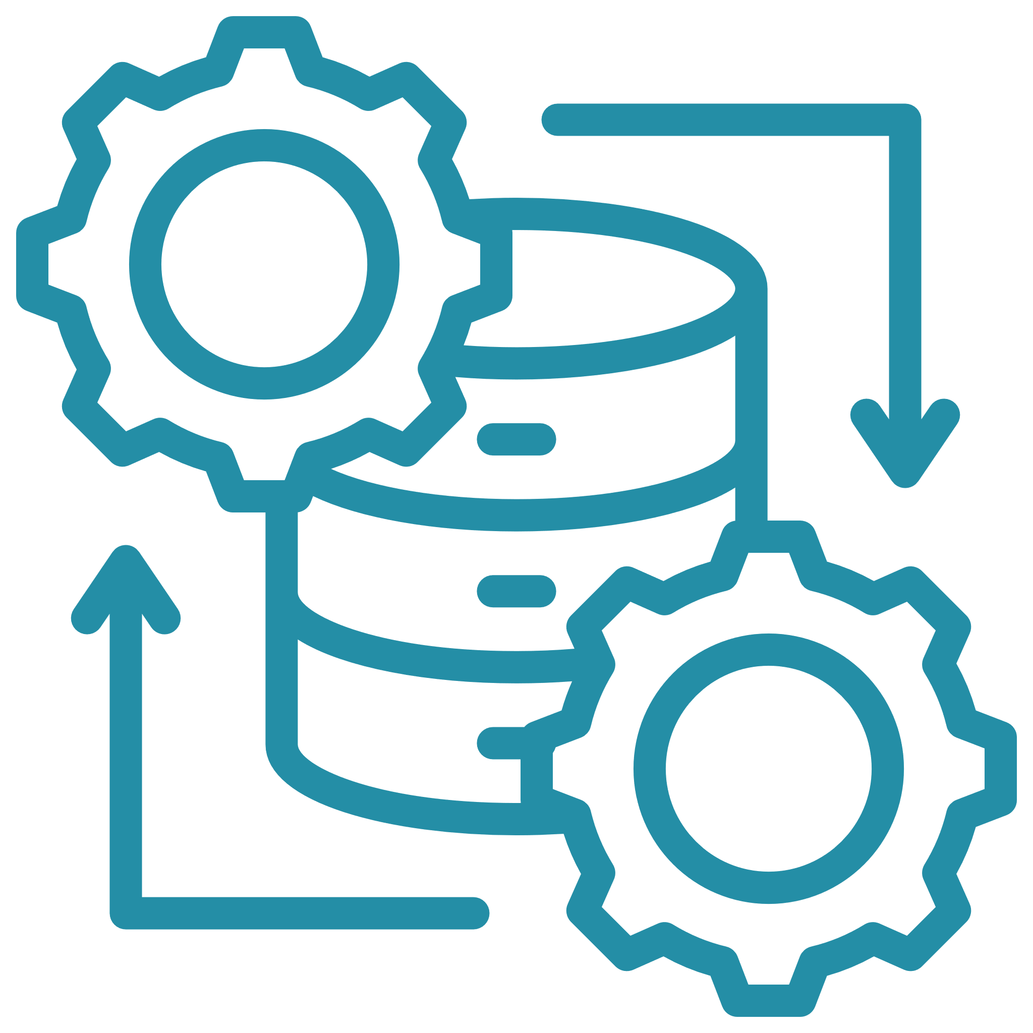


Federated Query
D a t a s o u r c e c o n n e c t o r s f o r i n - p l a c e a n a l y t i c s
Integrate external databases with your data lake
No data movement
Flexible and easy way to ingest data for analysis
Process data in place
On premises data
Amazon S3
Amazon RDS
MySQL

Slide 17





Data Source Connectors Use Cases
Interactive
Query
Business Intelligence
Data
Workflows
Analytics
Apps
Machine
Learning
Fast, scalable interactive queries on petabyte-scale data lakes
Visualizations and scheduled reporting on your data lake
Lightweight data workflows to prepare data for downstream use cases
Build applications that use athena to surface insights
Combine raw data from multiple sources to train more diverse models

Slide 18
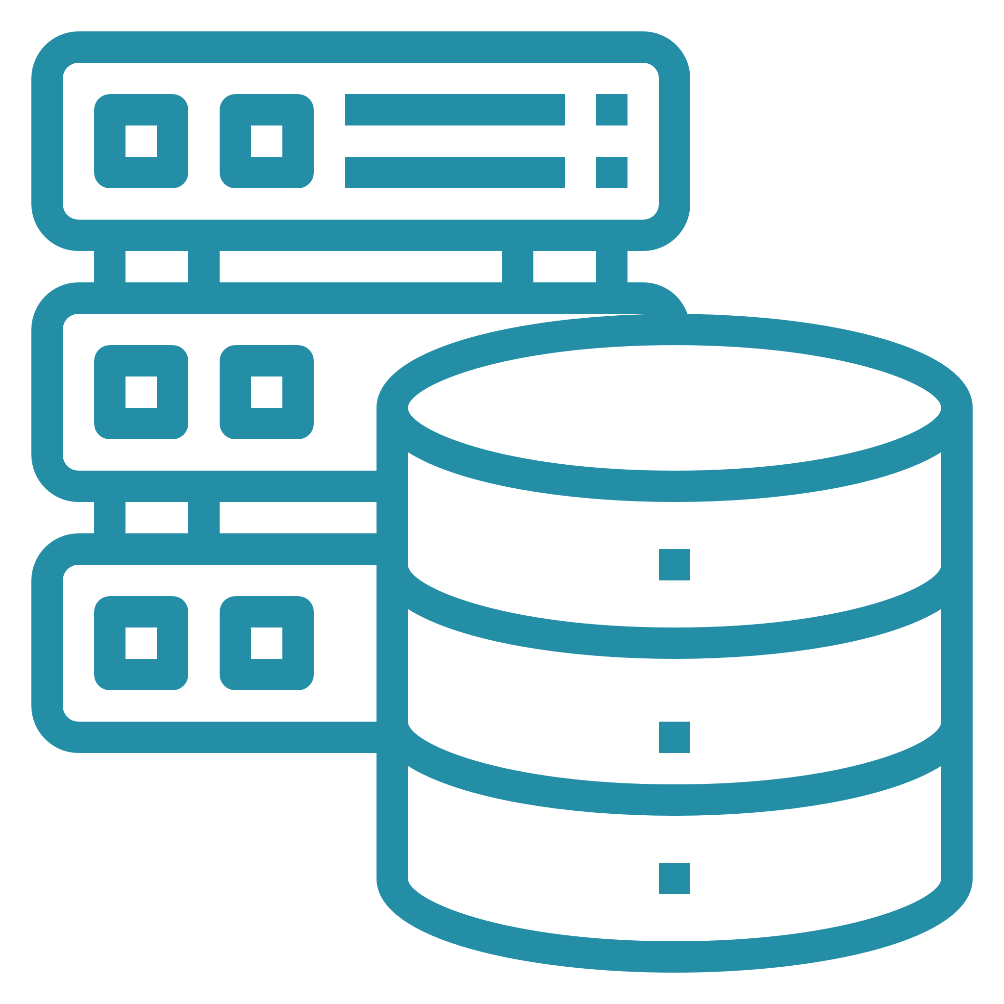
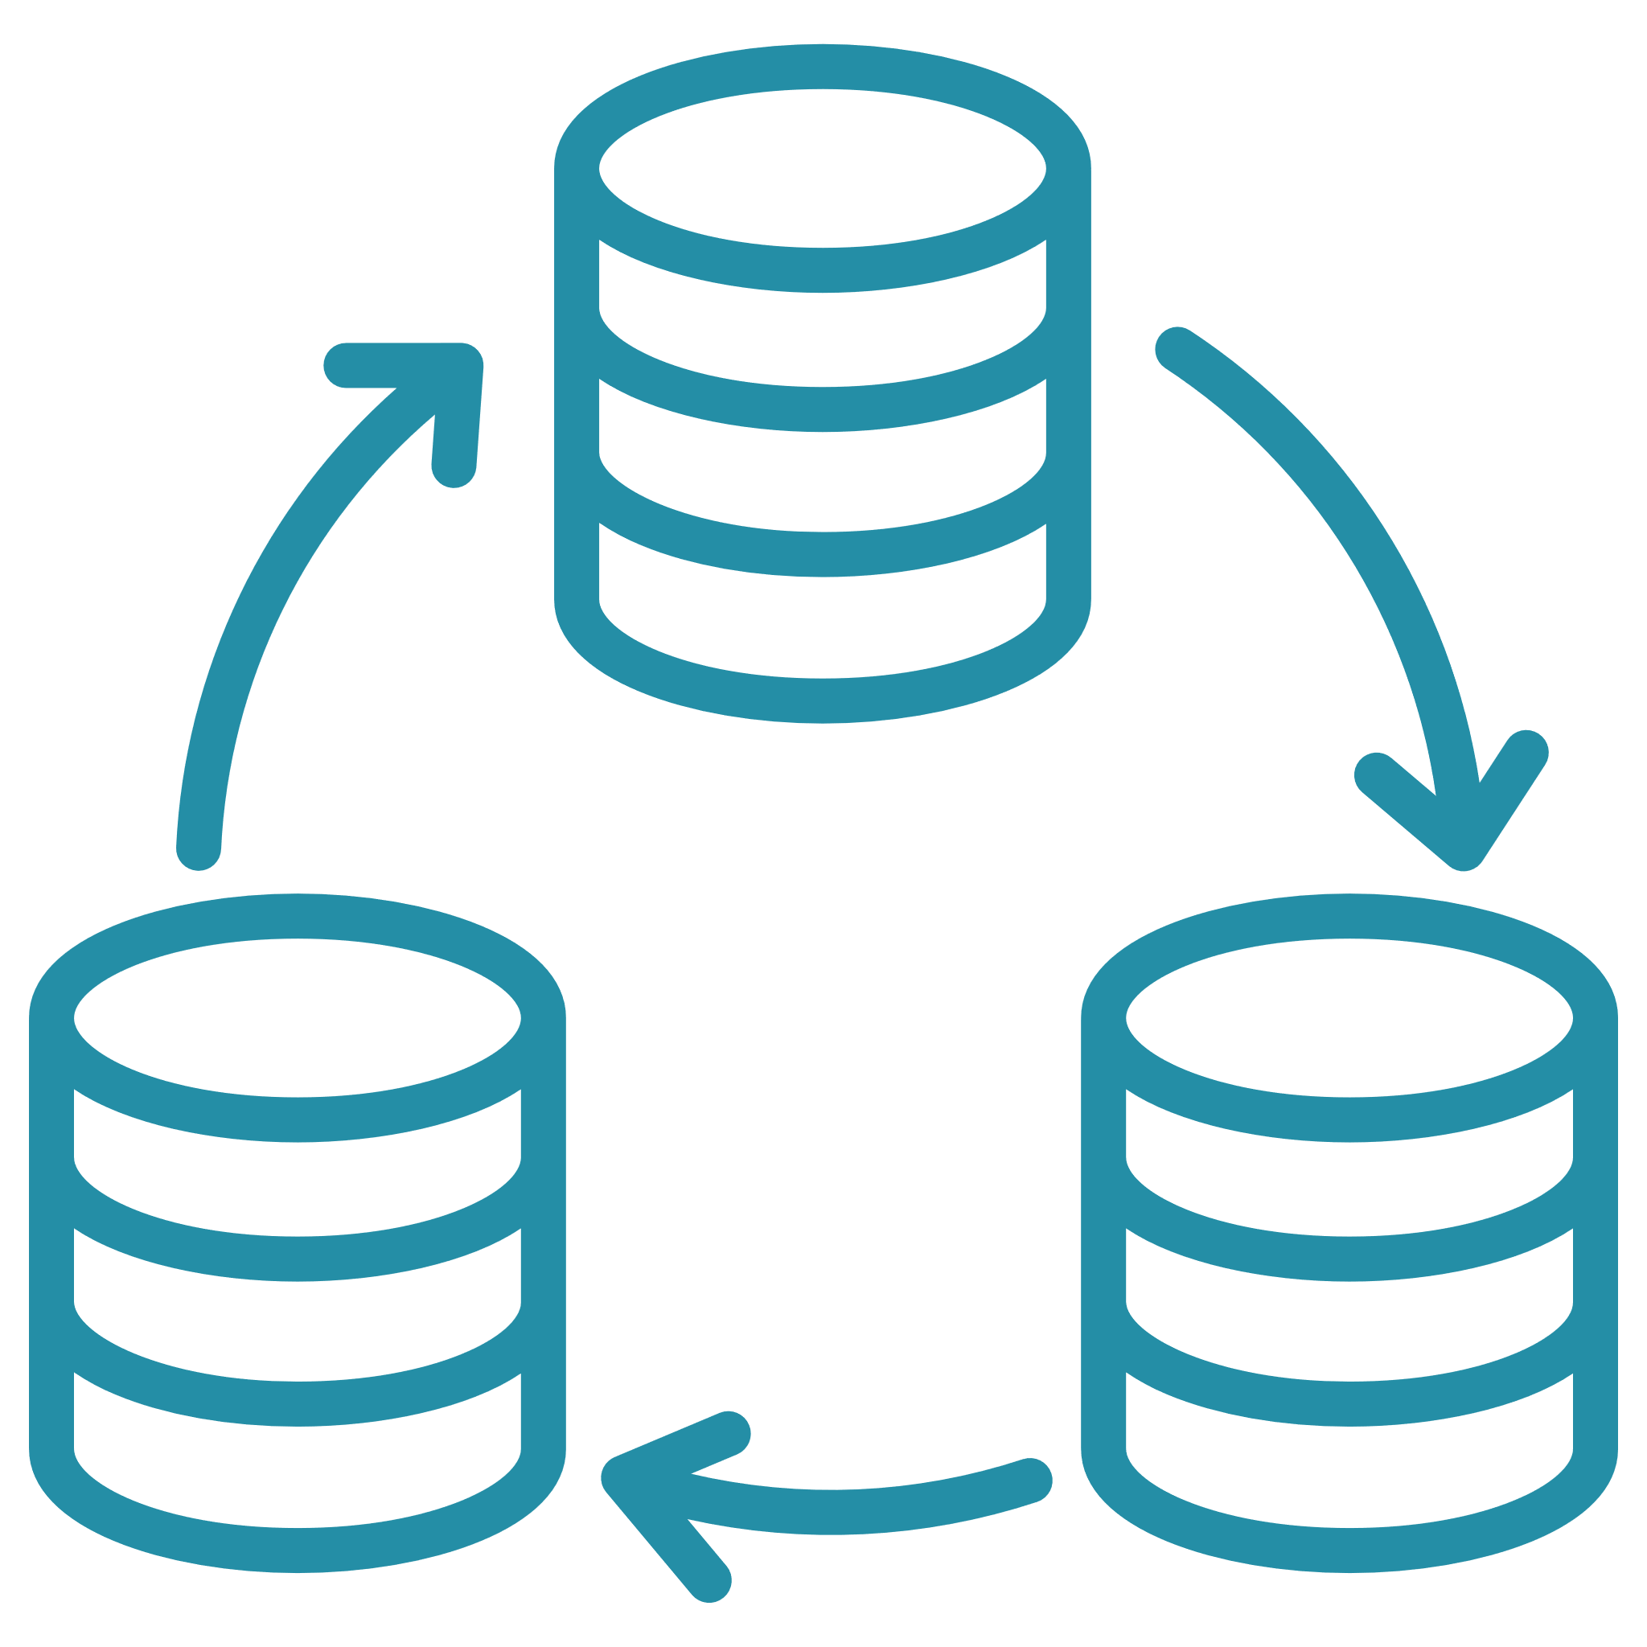




Amazon Timestream
S e r v e r l e s s , f u l l y m a n a g e d t i m e - s e r i e s d a t a b a s e
Collect, store, and process data sequenced by time at any scale
Serverless auto scaling for ingesting, storing, and querying
Data lifecycle management
No predefined schema
Access data across storage tiers with adaptive query engine
Built-in time-series
analytics in SQL
Integrates with ML, analytics, data collectors

Slide 19




Amazon QLDB
F u l l y m a n a g e d l e d g e r d a t a b a s e s e r v i c e
Immutable
Verifiable
Serverless
Easy to use
Append-only, immutable journal tracks history of all changes
All changes are cryptographically chained and verifiable
Scalable and highly available, no need to provision storage and I/O in advance
PartiQL offers familiar SQL operators, ION data model is rich and expressive

Slide 20
Purpose-built Databases
U s e t h e r i g h t t o o l f o r t h e j o b
Relational Databases
Key-value Databases
Document Databases
The “Ideal”
Database
Wide-column Databases
Graph Databases
Time-series Databases
Ledger Databases
. . . and more!

Slide 21
Adopt cloud-native relational databases
Amazon RDS, Amazon Aurora
Step 4
Specialized
data interactions
Systems of record
and ledgers
Amazon QLDB
Cache frequently accessed data
Amazon ElastiCache
Specialized datasets
Social graphs
Recommendation engines
Measurements
Time-series datasets Amazon Timestream
Persistent/durable
in-memory data structures
MemoryDB
Systems of record
Digital records
Benefits
Graphs and highly connected data Amazon Neptune
Key-value, globally accessible datasets Amazon DynamoDB
Agility
Scalability
Performance
Wide-column datasets
Amazon Keyspaces
Document type datasets Amazon DocumentDB

Slide 22



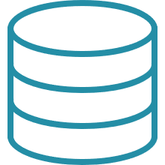


Data Lakes And Modern Data Architecture
Modern Data Architecture
Relational databases
Business
intelligence
Machine
learning
Big data processing
Non-relational databases
DW queries
Big data processing
Interactive
Real-time
Data Catalog
Data Lake
10011000010010101110
01010101110010101000
01011111011010
0011110010110010110
0100011000010
Log analytics
Machine learning
Data warehouse
Data lake
G
OLTP
ERP
CRM
LOB
Devices
Web
Sensors
Social
Data warehousing

Slide 23


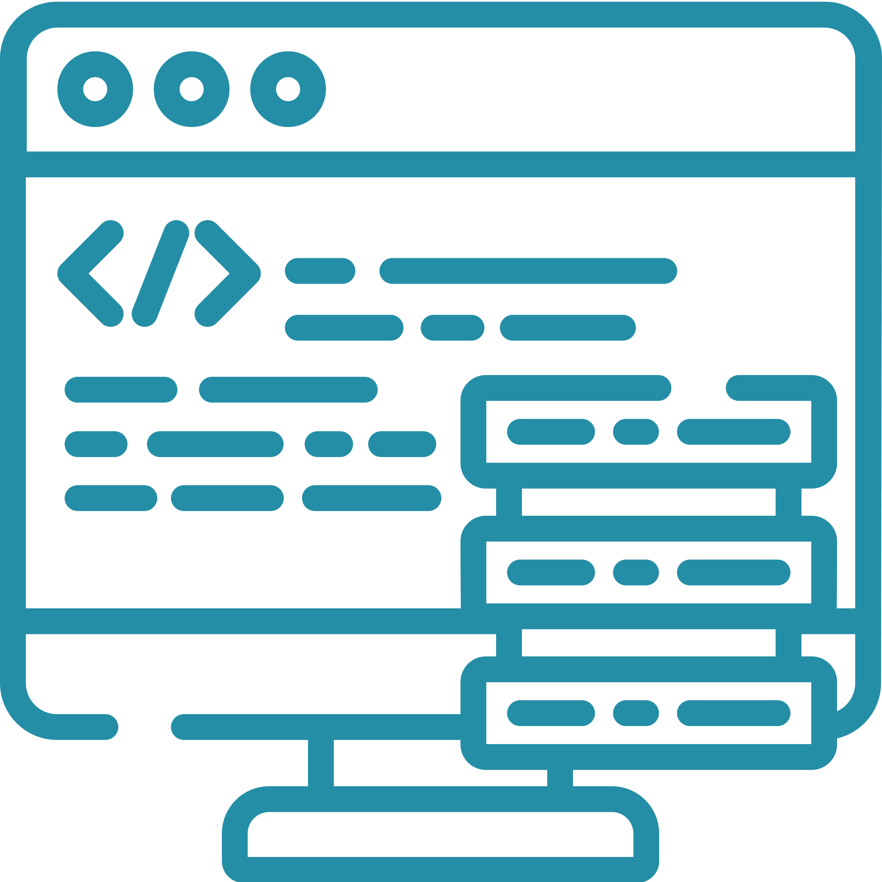



Data Virtualization With Athena
Data consumer
BI Dashboard
Mobile/web
Enterprise application
Exploration and discovery
AI/ML
AWS SDK/CLI
AWS APIs
JDBC/ODBC Data virtualization
Amazon Athena
AWS Glue
Data sources
On-premises data
Amazon S3
Amazon RDS
Amazon ElastiCache
MySQL
Amazon DocumentDB
Amazon Redshift
Snowflake

Slide 24

Data producer
Create Data
Product With Athena
Application VPC
Data domain producers ingest data into their respective S3 buckets through a set of pipelines that they own and operate
Orders database
Producers are data owners responsible for the full lifecycle of the data under their control
CTAS
Customer metadata
Producers catalog datasets to make them discoverable by consumers
Data catalog
Producers control access to data through Federated data governance model to enforce fine grained access control
Federated Data Governance
AWS Lake
Formation
Data catalog Data attributes
Policy control Data permissions

Slide 25

Amazon Aurora
The End Result
Amazon EMR
Amazon DynamoDB
With a data mesh architecture, we aim to
Amazon Athena
Amazon S3
Amazon Elasticsearch Service
Amazon SageMaker
Accelerate the independent delivery of business domain data lakes
Amazon RedShift
Access data
Consumer domain
Increase data security and compliance
within domains
Discover data product Request subscription
Amazon Aurora
Enable self-service data product creation, discovery, and subscription
Amazon EMR
Amazon DynamoDB
Create data product Approve subscription
Amazon Athena
Amazon S3
Data mesh
Amazon Elasticsearch Service
Amazon SageMaker
Allow consumers to transparently access data products
Amazon RedShift
Producer domain
Monitor, audit, and govern access over time
Monitor Audit Govern

Slide 26





Modernization at Amazon
Lesson Learned: Decompose For Innovation And Agility
Monolithic application
Microservices
Central database and dependent teams
Independent databases and two-pizza teams

Slide 27

What is Legend?
End-to-end data modeling and management platform
BUSINESS UNDERSTANDING
Create data models to enhance business understanding and codify imprecise concepts
DATA EXPLORATION
SOURCING & PUBLICATION
Explore and manipulate data, subject to entitlements, to understand and evaluate further investment
Publish data to other sources using APIs or conduct further processing for real-time sharing, all appropriately entitled
03
02
04
DATA DISCOVERY
GOVERNANCE
Discover important metadata and begin tackling business needs
Ensure data contracts and ownership are in place for shared governance with in-line constraints for safety and quality
01
05

Slide 28
Modernization at Amazon
Lesson Learned: Decompose For Innovation And Agility
Relational Database
Relational Database
Database – Database
Table – Collection
Row – Document
name | company | userID | state
Douglas | AWS | dbonser | TX
Cody | AWS | allco | TX
{
"name": "Douglas",
"company": "AWS",
"userID": "dbonser",
"state": "TX"
}
{
"name": "Cody",
"company": "AWS",
"userID": "allco",
"state": "TX"
}
Column – Field

Slide 29
Lessons learned
AWS
Demand for new, broad, deep data
Petabyte-scale relational analytics
Live third-party data sharing
Serverless extract, transform, load
Digital assets
ESG
Unstructured data
Highly complex relational data
Goldman Sachs Financial Cloud for Data
Extensive curated financial data
Optimized time-series analytics
Scalable compute and storage
Real-time analytics enabled by streaming data
Plan and prepare
Serverless and managed for the win
Data lineage and ontology from Day 1
Engage early with security team
On-premise and cloud systems must work together

Slide 30



What is Athena?
Athena Scale
CIB Markets Business
4k+
50MM
#1
100
Python
Developers
Lines of
Code
In Markets
Revenue
Markets
Globally
20K
One of the
world’s largest
$29.5B
Production
Changes/week
Python
Repositories
2020 Markets Revenue
Athena Platform
Models
Environments
Trade Management
Risk
Frameworks
Development Tooling
Pricing

Slide 31

What is Athena Risk Management?
Athena Scale
Risk Scheduler
5BN
Market Data
Risk Models
Financial Products
Calculations per day
10K
Risk Scheduler
Results
Batch jobs per day
50K
Risk Worker CPU/GPU grid
CPU grid

Slide 32
Common Challenges With Data Preparation In Machine Learning
Data preparation accounts for 80% of the work of data scientists
01.
Time-consuming and resource-intensive
Collecting
datasets
02.
Requires multiple tools
03.
Data preparation tools are typically not DevOps friendly
04.
Common data preparation tasks require writing code
Source: Forbes survey of 80 data scientists, March 2016

Slide 33
It Gets Worse When You Have To Repeat Processes
DATA
SOURCES
DATA SCIENCE
PIPELINES
M O D E L S
Checking
account services
Fraud prediction
Credit card
services
Security
team
Customer churn
Other transaction services
Next best action

Slide 34
Amazon SageMaker Overview
PREPARE
BUILD
TRAIN & TUNE
DEPLOY & MANAGE
SageMaker Ground Truth
Label training data for machine learning
SageMaker Studio notebooks Jupyter notebooks with elastic compute and sharing
Managed training
Distributed infrastructure management
Managed deployment
Fully managed, ultra-low latency, high throughput
Built-in and bring-your-own algorithms
Dozens of optimized algorithms, or bring your own
SageMaker Experiments Capture, organize, and compare every step
Kubernetes and Kubeflow integration
Simplify Kubernetes-based
machine learning
SageMaker Data Wrangler Aggregate and prepare data for machine learning
Automatic model tuning
Hyperparameter optimization
Multi-model endpoints
Reduce cost by hosting multiple models per instance
SageMaker Processing
Built-in Python, BYO R/Spark
Local mode
Test and prototype on your local machine
Distributed training libraries
Training for large datasets
and models
SageMaker Model Monitor
Maintain accuracy of deployed models
SageMaker Feature Store
Store, update, retrieve, and share features
SageMaker Autopilot Automatically create machine learning models with full visibility
SageMaker Debugger
Debug and profile training runs
SageMaker Edge Manager Manage and monitor models on edge devices
SageMaker JumpStart
Prebuilt solutions for common use cases
SageMaker Pipelines
Workflow orchestration and automation
Managed spot training
Reduce training cost by 90%
SageMaker Studio
Integrated development environment (IDE) for ML

Slide 35
How SageMaker Data Wrangler works
Select
and query
Visualize
Cleanse
and enrich
Understand
Operationalize
Select and query data from a variety of data sources such as
Amazon Athena, Amazon Redshift, AWS Lake Formation, and Amazon S3
Graphically understand data and detect outliers with preconfigured visualization templates
Cleanse and explore data, perform feature engineering with built-in data transforms, and detect statistical bias with SageMaker Clarify
Use a sample dataset to quickly estimate model performance and accuracy and diagnose potential issues
Export data preparation workflow to a notebook or code script to bring the workflow into production
Amazon SageMaker Data Wrangler
A faster, visual way to aggregate and prepare data for machine learning
Import data from a feature store such as Amazon SageMaker Feature Store
Integrate data preparation workflow with Amazon SageMaker Pipelines
Export prepared data into Amazon SageMaker Feature Store

